Slide 1
What is Machine Learning?
Machine Learning is a set of techniques to make computers better at doing things that humans can do better than machines.
Machine learning involves making machines learn things like humans do.

Slide 2
The term machine learning was coined in 1959 by Arthur Samuel
It is a branch of artificial intelligence based on the idea that systems can learn from data, identify patterns and make decisions with minimal human intervention.
Artificial intelligence is a field of computer science that makes a computer system that can mimic human intelligence. It is comprised of two words “Artificial” and “intelligence”, which means “a human-made thinking power.”
On the other hand, Machine learning enables a computer system to make predictions or take some decisions using historical data without being explicitly programmed.

Slide 3
How Machine Learning works?
The Machine Learning process starts with inputting training data into the selected algorithm. Training data being known or unknown data to develop the final Machine Learning algorithm.
To test whether this algorithm works correctly , new input data is fed into the Machine Learning algorithm. The predictions and results are then checked.

Slide 4
How machine learning works contd…
If the prediction is not as expected, the algorithm is re-trained multiple number of times until the desired output is found.
This enables the Machine Learning algorithm to continually learn on its own and produce the most optimal answer that will gradually increase in accuracy over time.

Slide 5
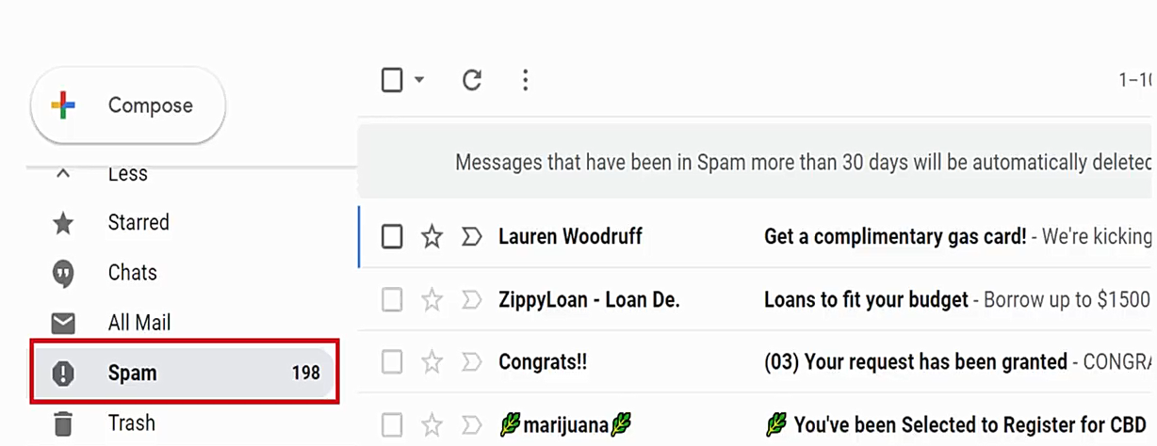
Examples -

Slide 6
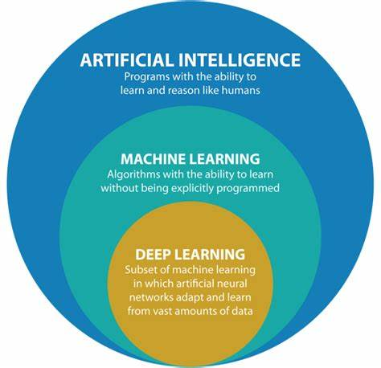

Slide 7

Examples contd..

Slide 8

Examples contd..

Slide 9
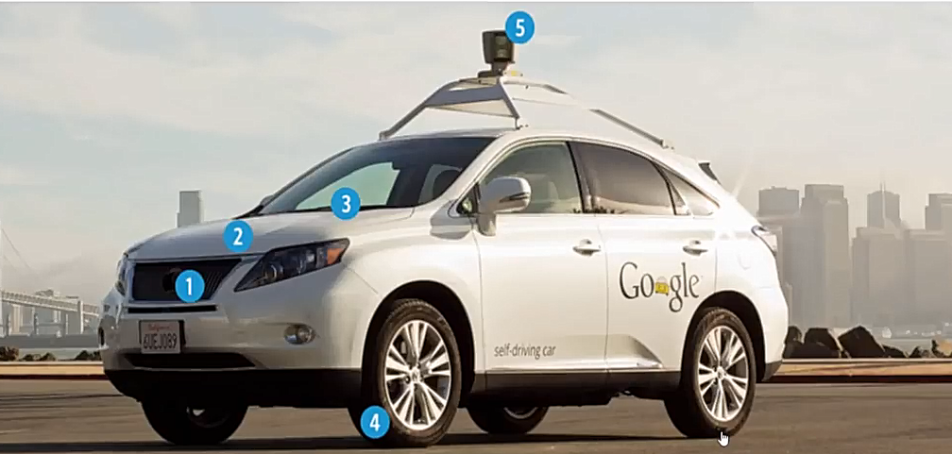
Examples contd..

Slide 10
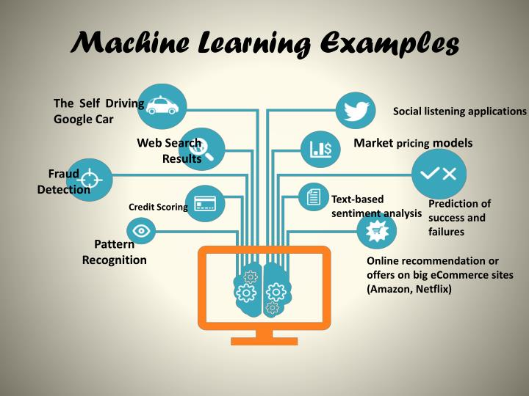

Slide 11
Types of Machine Learning
Machine learning consists of applying mathematical and statistical approaches to get machines to learn from data.
Supervised learning
Unsupervised learning
Reinforcement learning

Slide 12
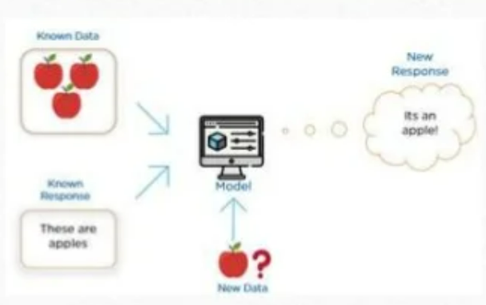
Supervised Learning
Supervised Learning describes a class of problem that involves using a model to learn a mapping between input examples and the target variable. It is the learning in which a supervisor teaches or trains a machine using labelled data with correct answers. Models are fit on training data comprised of inputs and outputs and used to make predictions on test sets where only the inputs are provided and the outputs from the model are compared to the target variables.

Slide 13
Types of Supervised Learning problems
Supervised learning problems can be further grouped into Regression and Classification problems. Both problems have as goal the construction of a model that can predict the value of the dependent attribute from the independent variables.
The difference between the two tasks is the fact that the dependent attribute is numerical for regression and categorical for classification.

Slide 14
Classification & Regression
It is the process of finding or discovering a model or function which helps in separating the data into multiple categorical classes i.e. discrete values. In classification, data is categorized under different labels according to some parameters given in input and then the labels are predicted for the data. Classification algorithms are used to predict/Classify the discrete values such as Male or Female, True or False, Spam or Not Spam, etc.
On the other hand, regression will not give a class as output. The output is a specific value also called a forecast or prediction. Regression algorithms are used to predict the continuous values such as price, salary, age, etc. Regression analysis is a statistical process for estimating the relationships among independent and dependent variables.

Slide 15
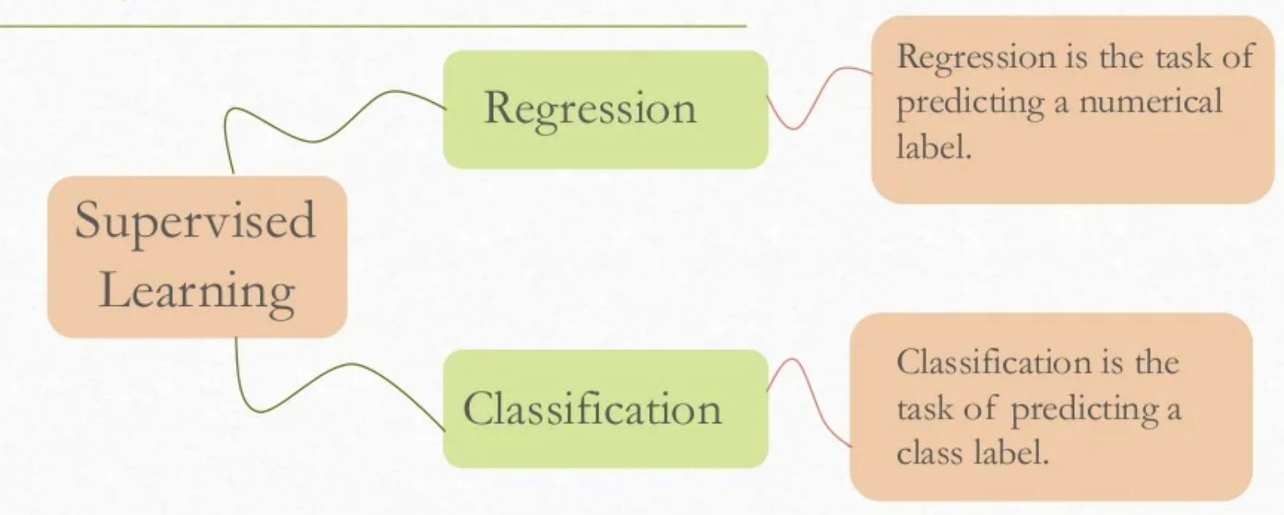

Slide 16
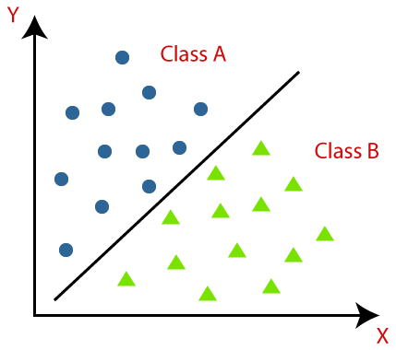
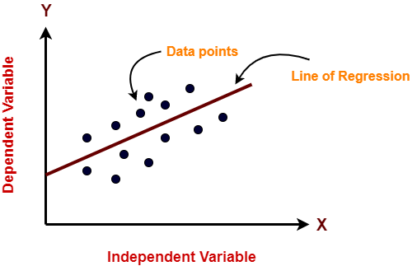
Classification
Regression

Slide 17
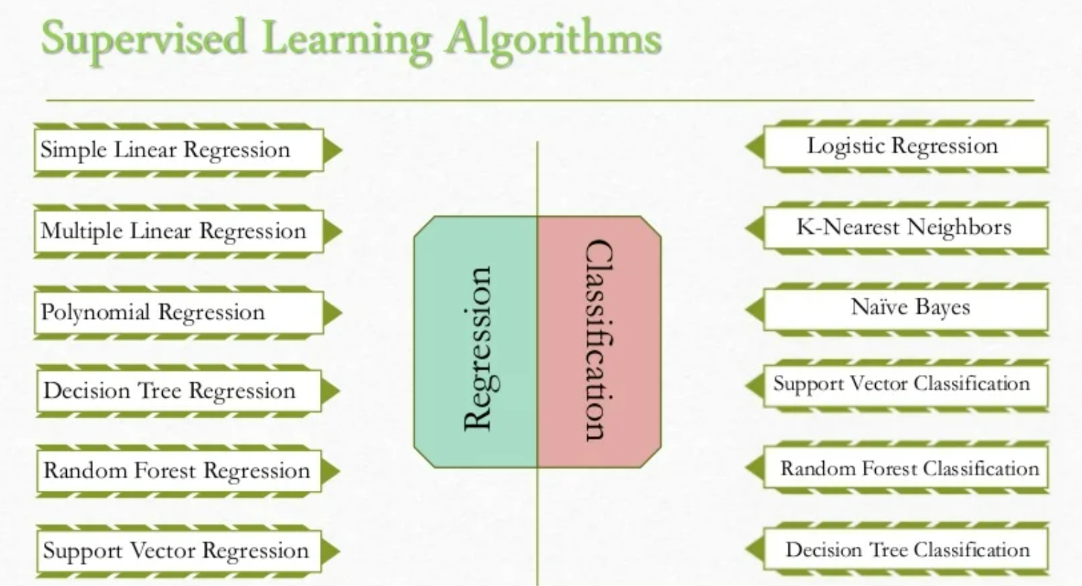

Slide 18
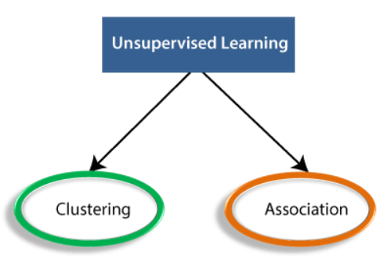
Unsupervised Learning
Unsupervised Learning is a class of Machine Learning techniques to find the patterns in data. The data given to unsupervised algorithm are not labelled, which means only the input variables(X) are given with no corresponding output variables. In unsupervised learning, the algorithms are left to themselves to discover interesting structures in the data.

Slide 19
Clustering - In clustering, the data is divided into several groups. In plain words, the aim is to segregate groups with similar traits and assign them into clusters.
Example - Netflix uses this technique to recommend the movies and web-series to its users as per the watch history.
Association - An association rule is an unsupervised learning method which is used for finding the relationships between variables in the large database. It determines the set of items that occurs together in the dataset. Association rule makes marketing strategy more effective.
Such as people who buy X item (suppose a bread) are also tend to purchase Y (Butter/Jam) item. A typical example of Association rule is Market Basket Analysis.

Slide 20
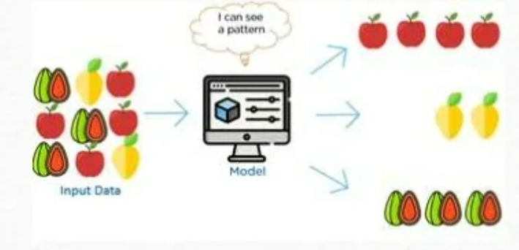
Unsupervised learning describes a class of problems that involves a model to describe or extract relationships in data. Unsupervised learning operates upon only the input data without outputs or target variables. Unsupervised learning does not have any teacher correcting the model.

Slide 21
Supervised Learning Unsupervised Learning
Supervised learning algorithms are trained using labeled data. | Unsupervised learning algorithms are trained using unlabeled data.
Supervised learning model takes direct feedback to check if it is predicting correct output or not. | Unsupervised learning model does not take any feedback.
Supervised learning model predicts the output. | Unsupervised learning model finds the hidden patterns in data.
Supervised learning needs supervision to train the model. | Unsupervised learning does not need any supervision to train the model.
Supervised learning can be categorized in Classification and Regression problems. | Unsupervised Learning can be classified in Clustering and Associations problems.

Slide 22
Supervised Learning Unsupervised Learning
Supervised learning model produces an accurate result. | Unsupervised learning model may give less accurate result as compared to supervised learning.
It includes various algorithms such as Linear Regression, Logistic Regression, Support Vector Machine, Multi-class Classification, Decision tree, Bayesian Logic, etc. | It includes various algorithms such as Clustering, KNN, and PCA algorithm.

Slide 23
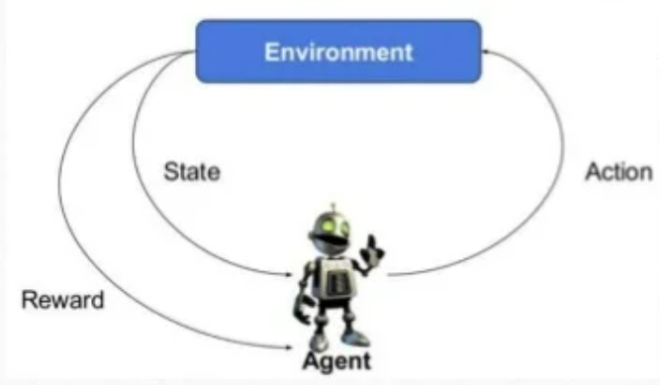
Reinforcement Learning
Reinforcement learning describes a class of problems where an agent operates in an environment and must learn to operate using feedback. Reinforcement learning is learning what to do – how to map situations to actions so as to maximise a numerical reward signal. The learner is not told which actions to take, but instead must discover which actions yield the most reward by trying them.

Slide 24
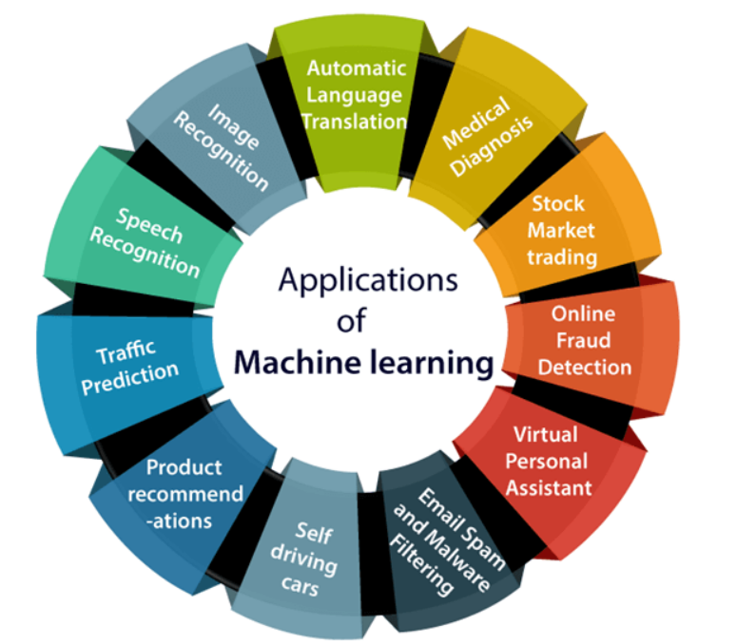
Applications of Machine Learning

Slide 25
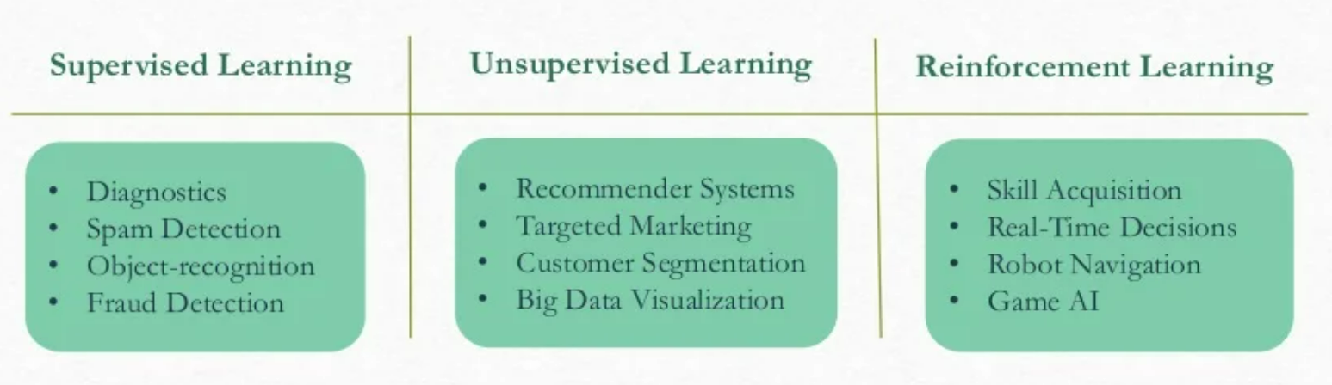
Applications of Machine Learning

Slide 26
Important Questions
What is machine learning? Explain different types of machine learning.
Difference between supervised and unsupervised learning.
Difference between regression and classification.
Explain the different application areas of machine learning.
How can we represent a supervised learning model. Explain.
Write short note on Reinforcement learning.

Slide 27
Thank You
-Prepared by
Jheelam Mondal
Assistant Professor
CSE Department
Haldia Institute of Technology

